Slide 1
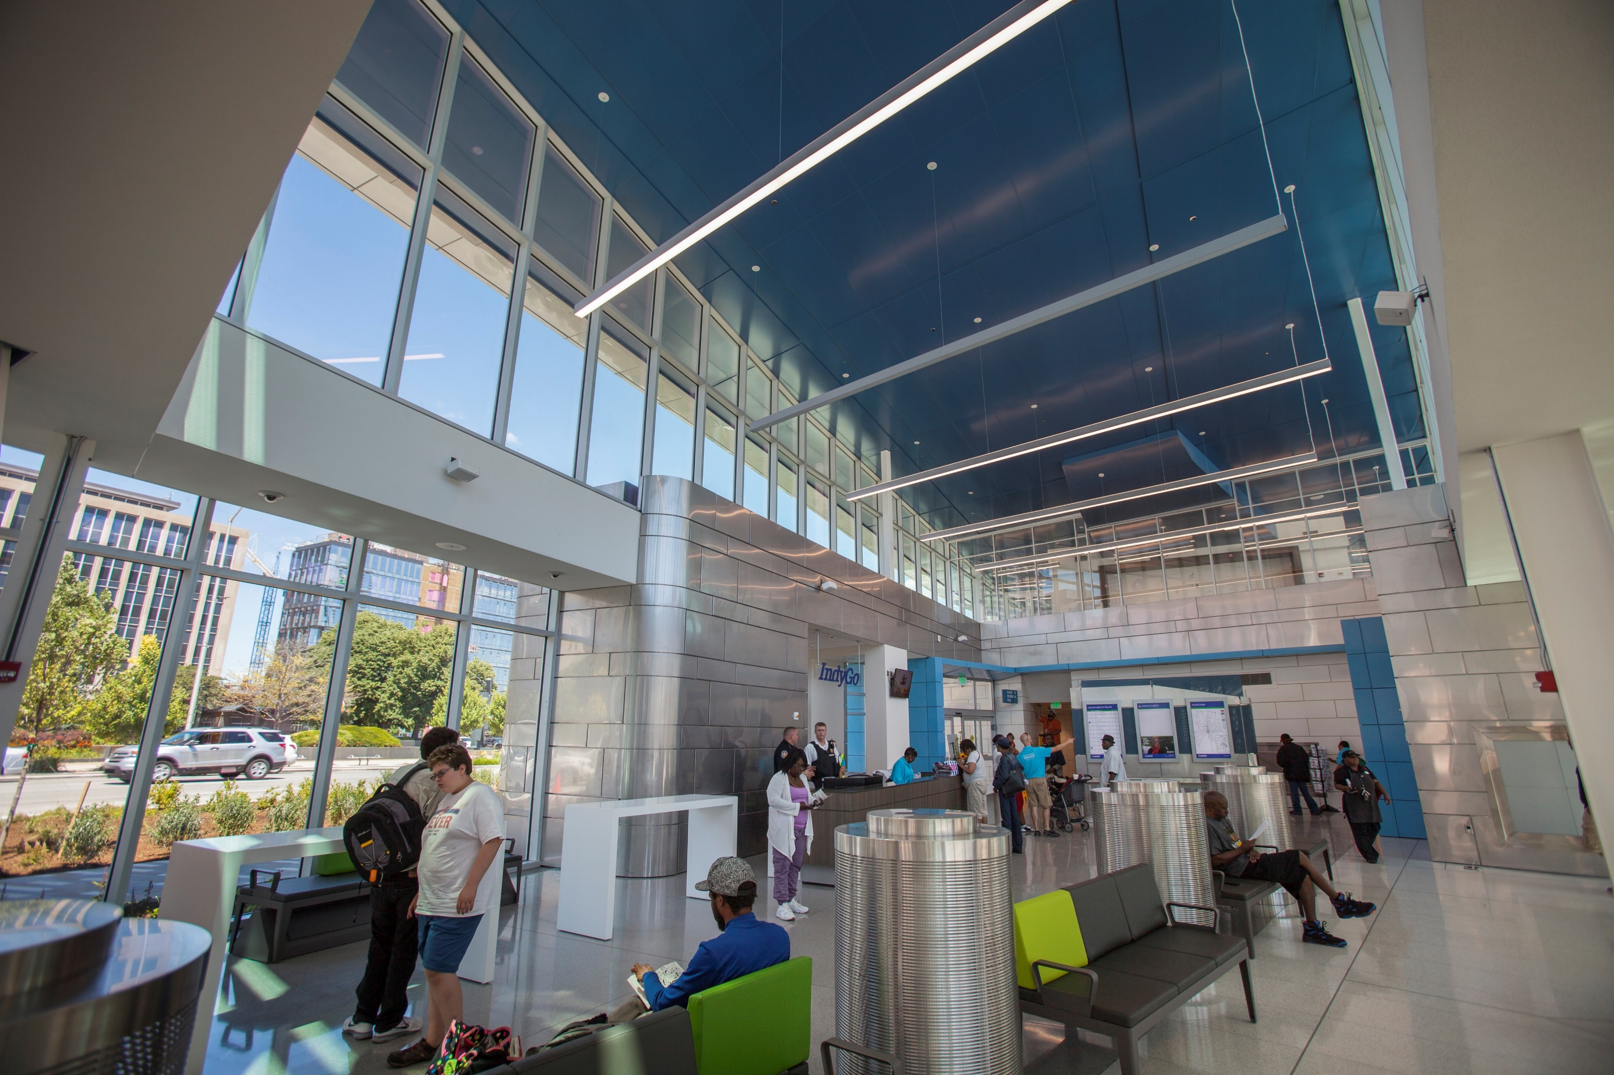

May 2018 Update
2018 Route Improvements &
Draft Service Standards

Slide 2
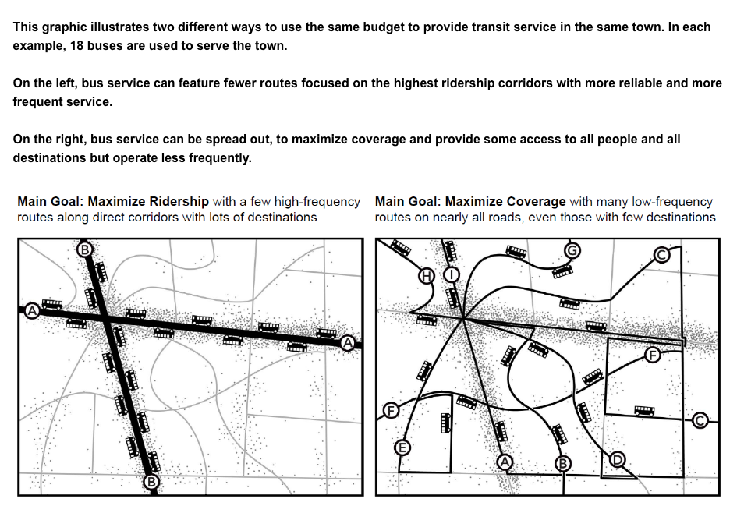
Ridership vs Coverage
IndyGo Split: 80% / 20%

Slide 3
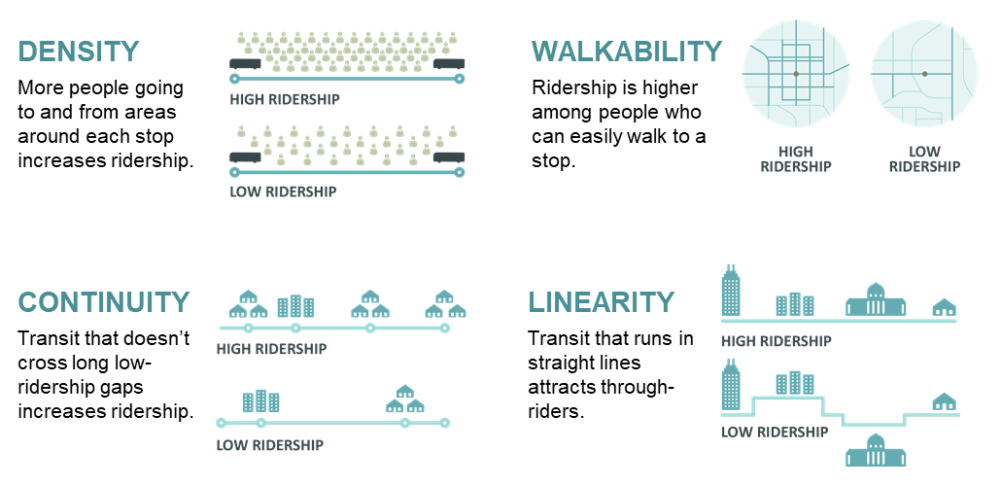
Ridership Recipe

Slide 4
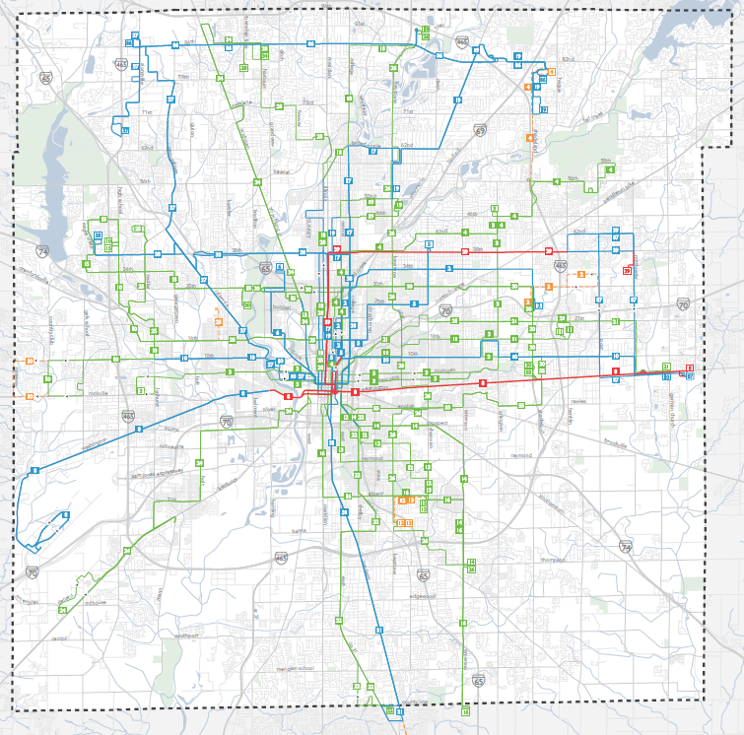
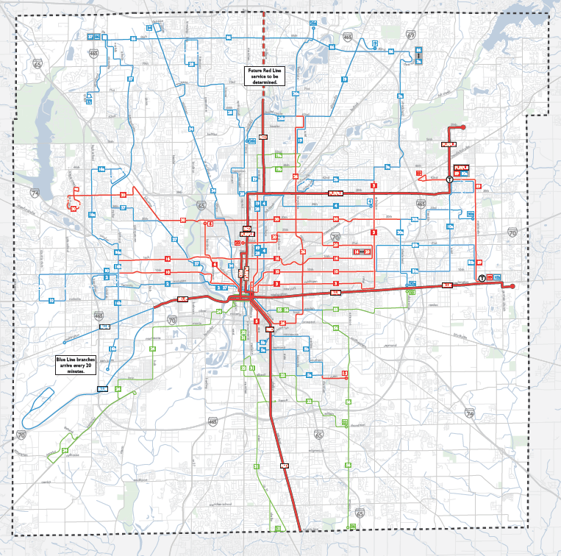
Evolution to 80% ridership

Slide 5
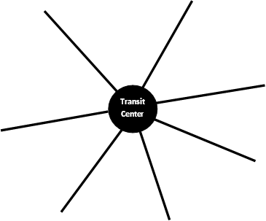
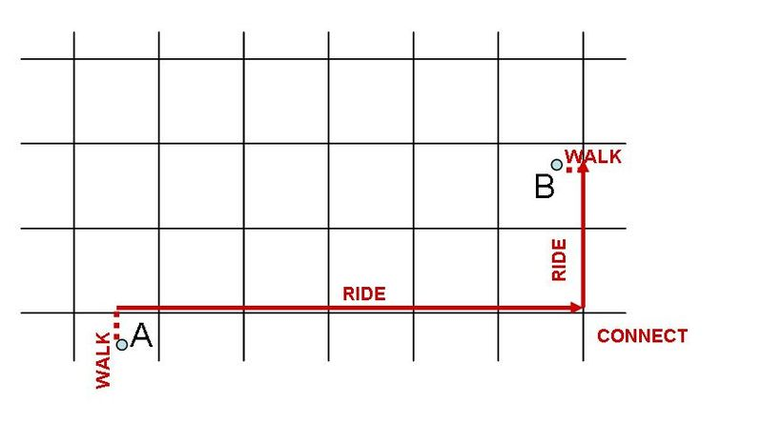
From Hub & Spoke to Frequent Grid
Notes:
Not everyone is going downtown anymore?

Slide 6
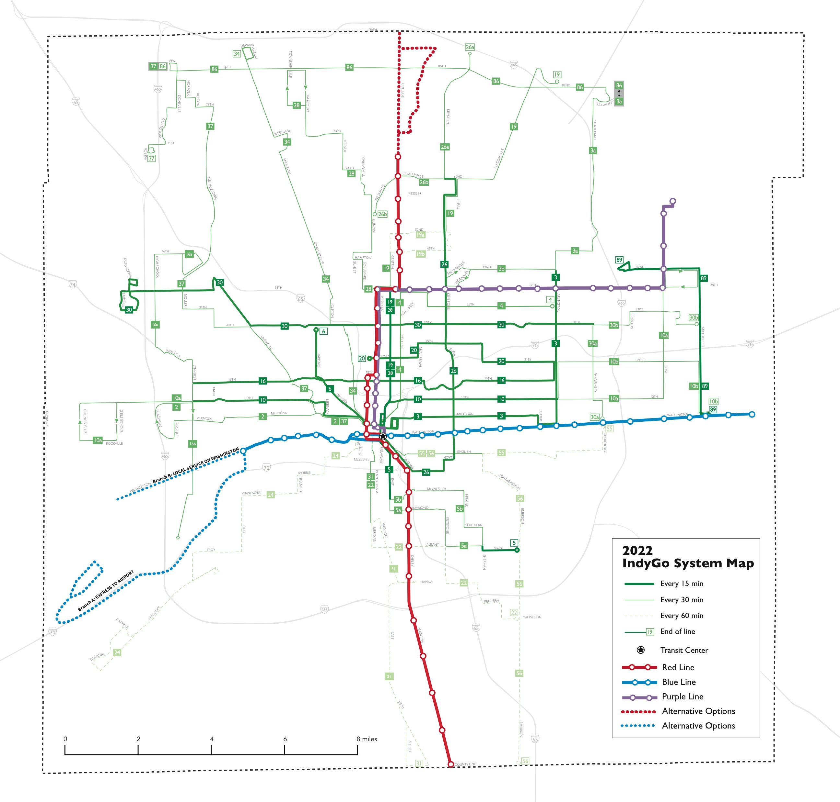

Slide 7
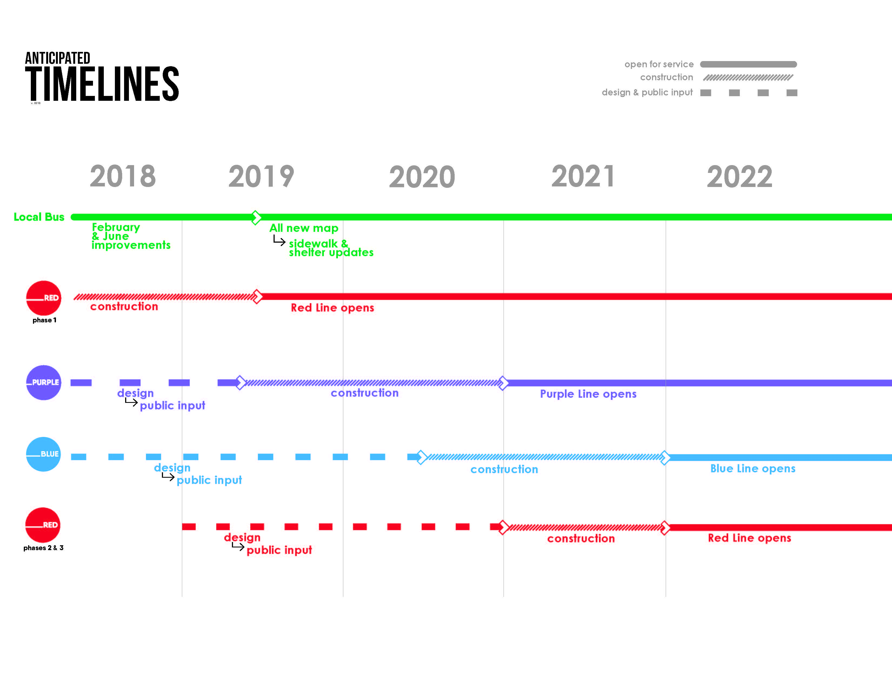

Slide 8
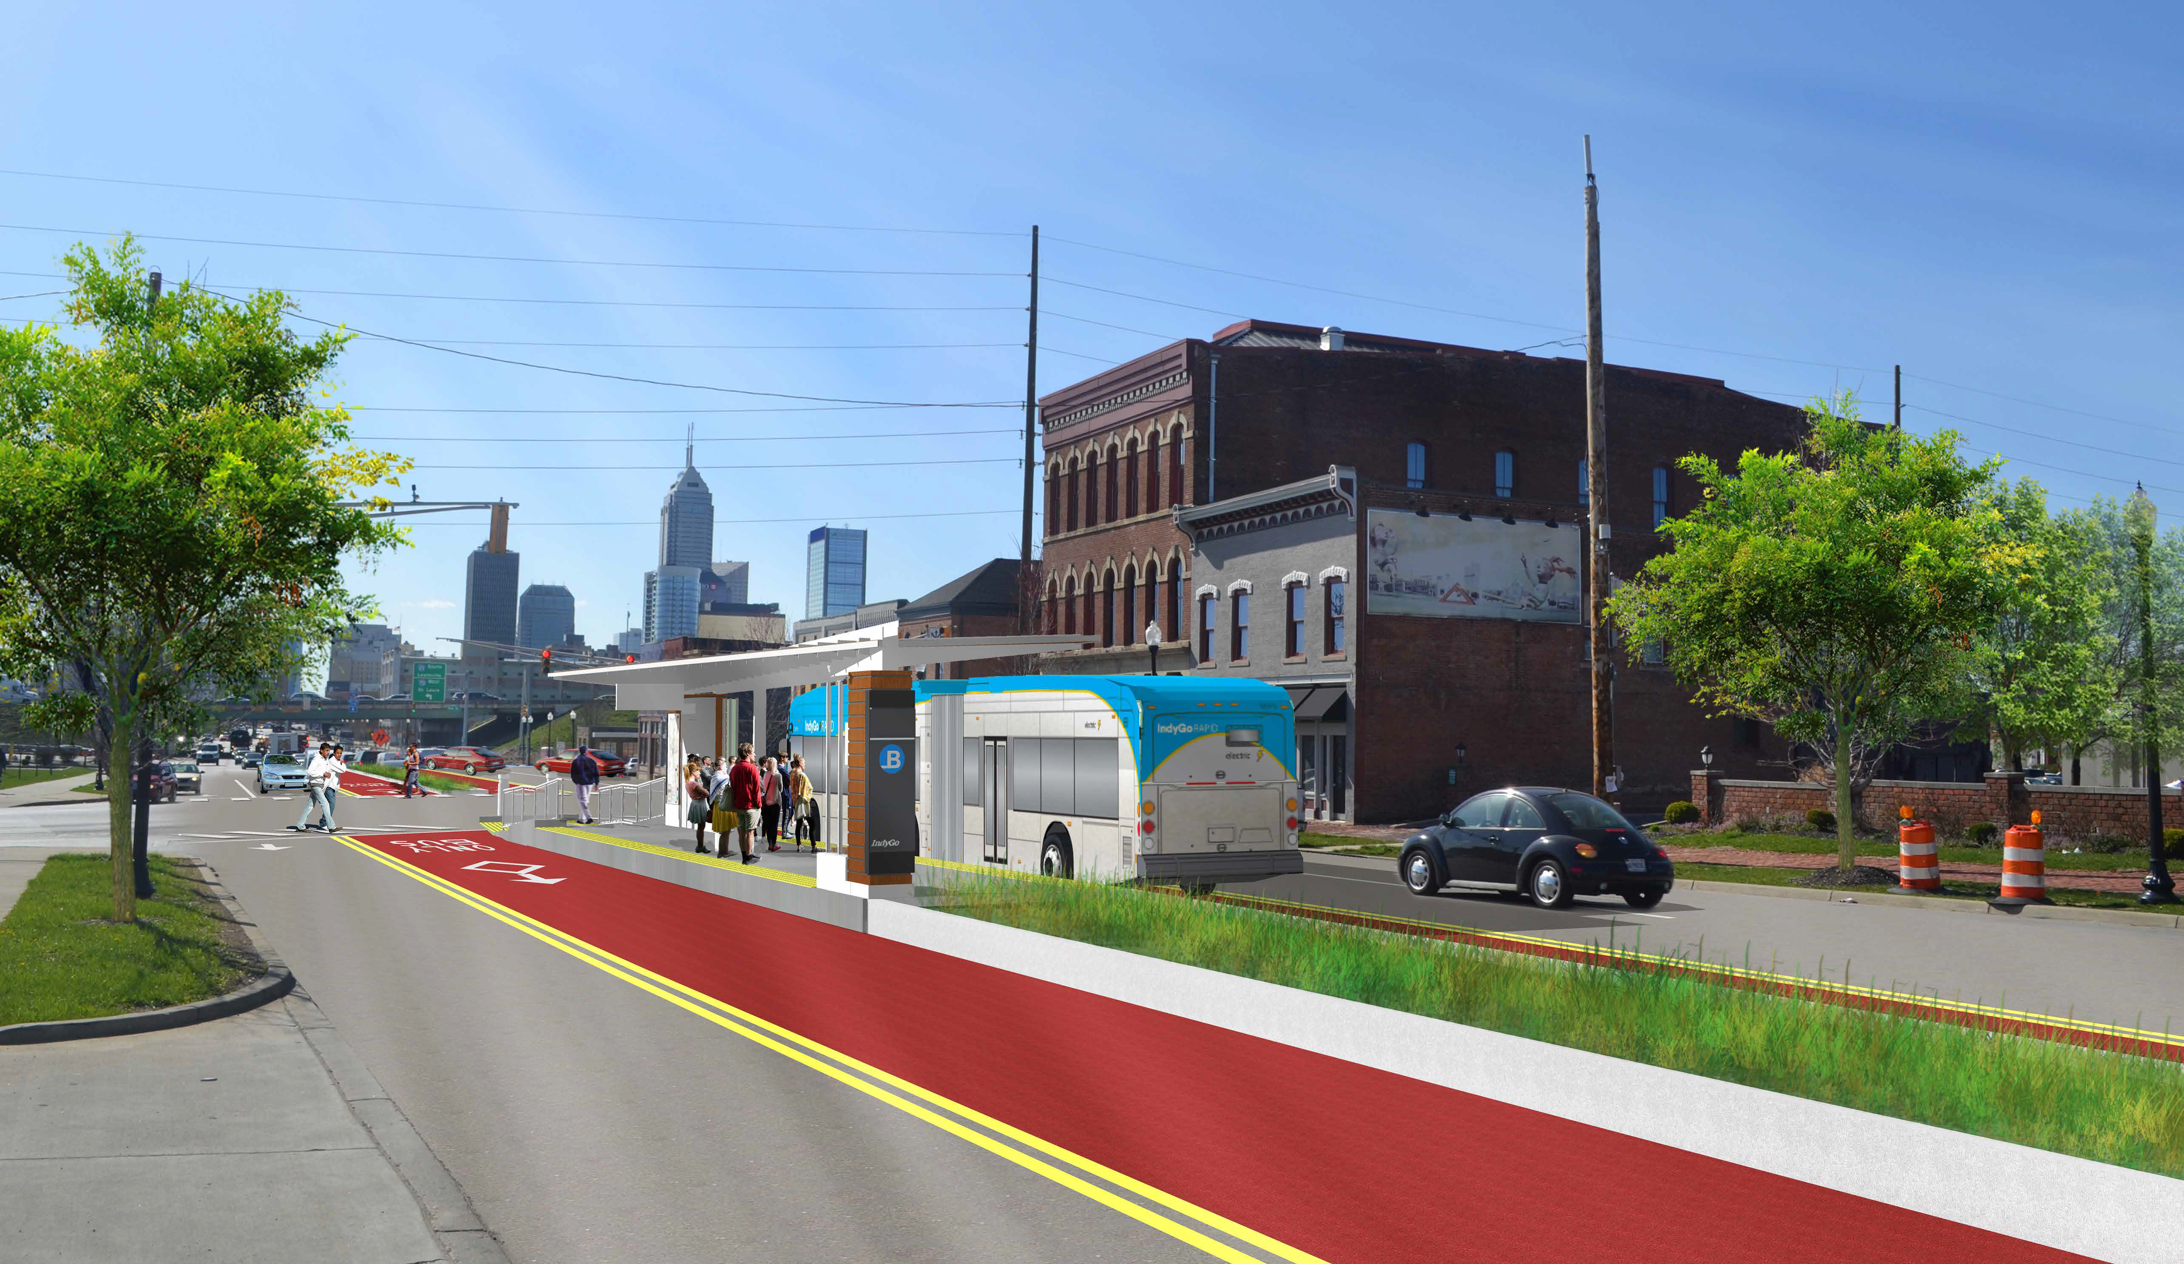
Blue line
Wednesday, 30 at 6:00 PM
Shepherd Community Ctr
4107 E Washington St
Wednesday, June 6 at 6:00PM
Wayne Twp Govt Center
5401 W Washington St
Thursday, 31 at 6:00 PM
Ransburg YMCA
501 N Shortridge Rd
Tuesday, June 5 at 12:00PM
Central Library
40 E Saint Clair St
Tuesday, June 5 at 6:00PM
Central Library
40 E Saint Clair St

Slide 9
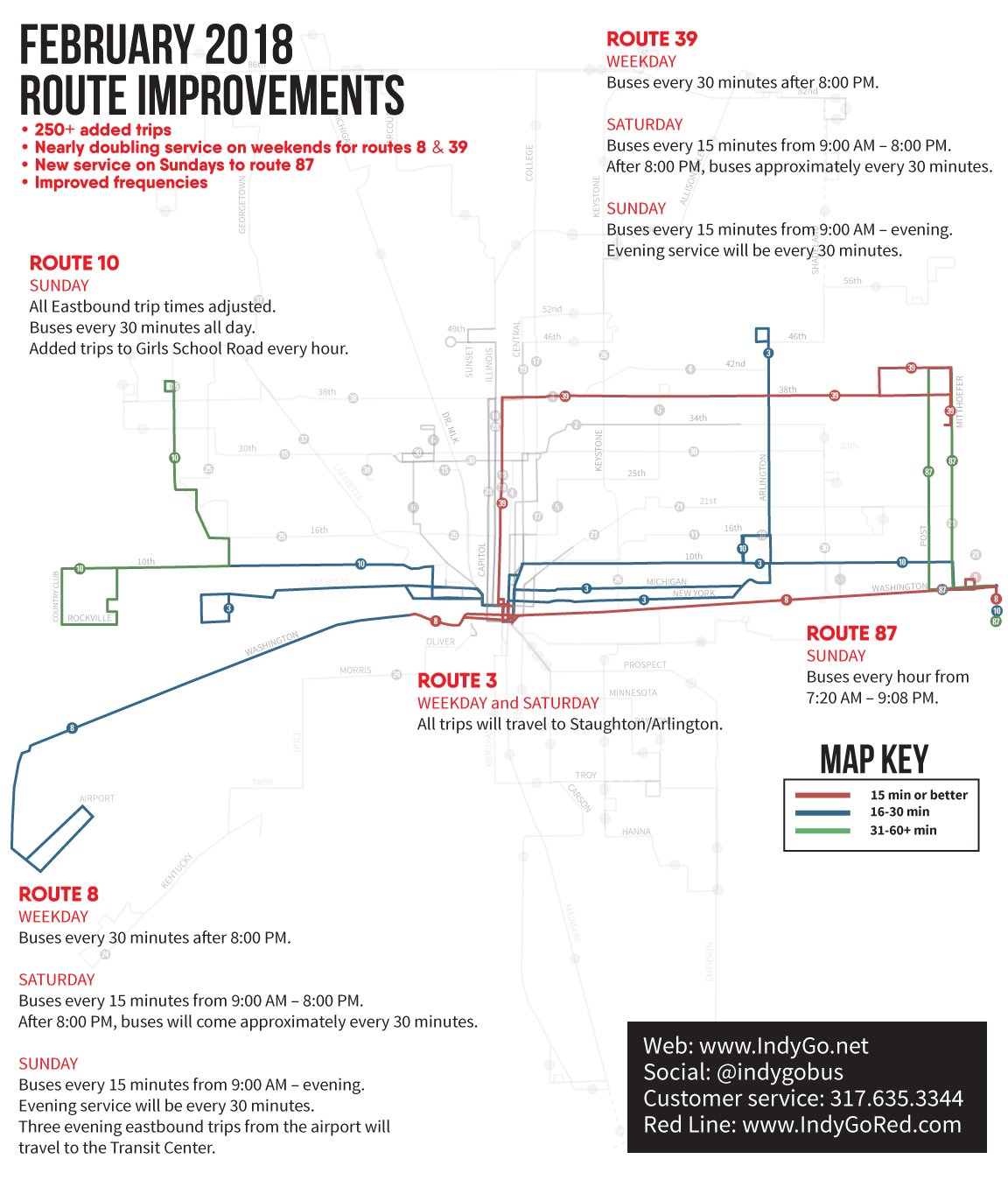

Slide 10
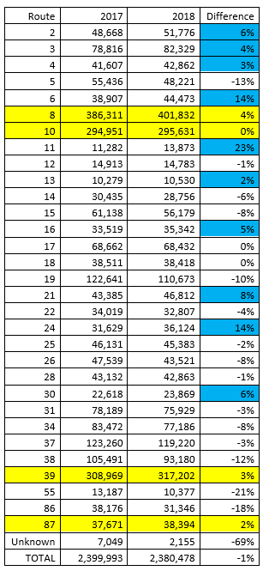
Investment brings ridership
Feb – March 2018
8, 10, 39, 87 up 4.2%
Some other increases (blue)
Non-improved routes
down 3.3%
Improved routes performed
7.5% better

Slide 11
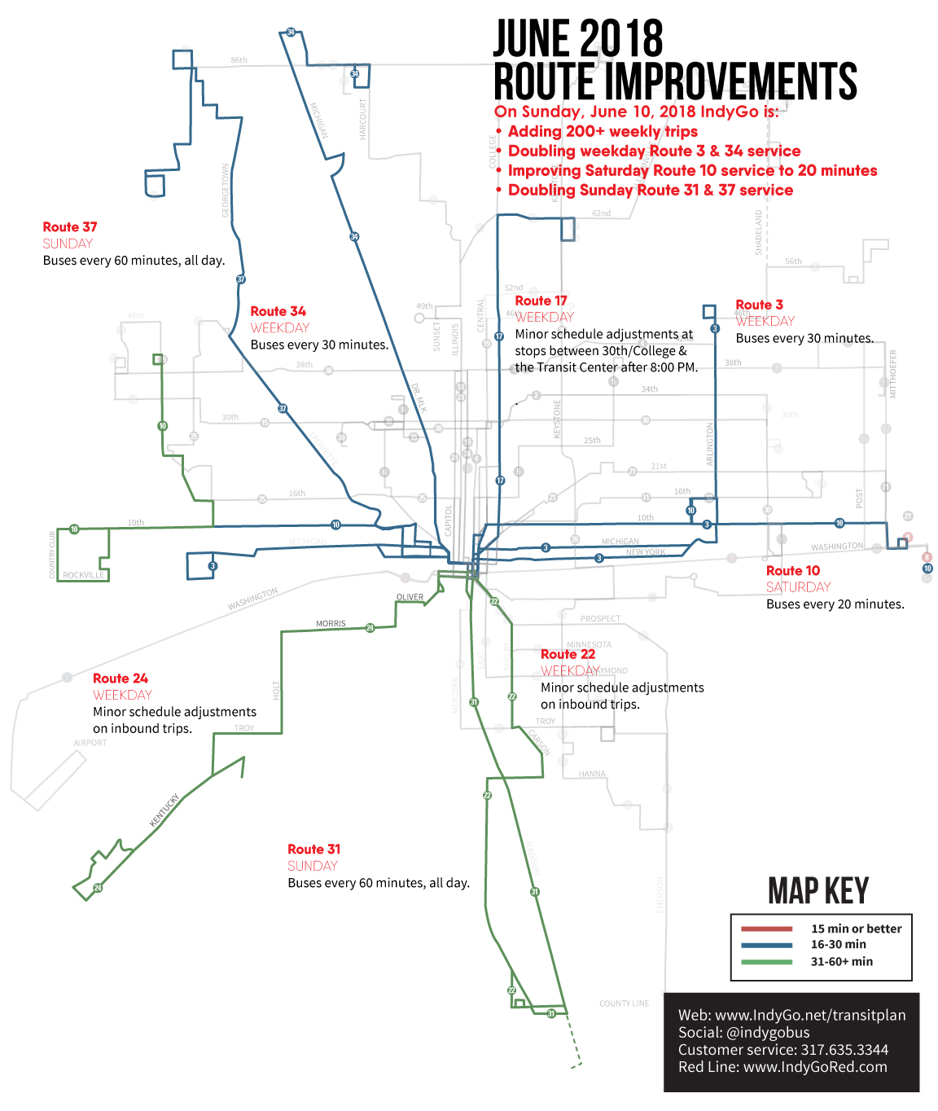

Slide 12
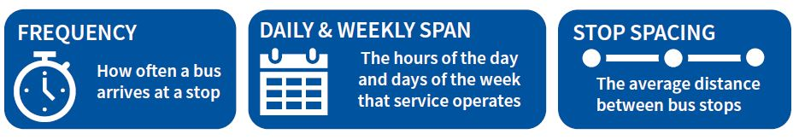
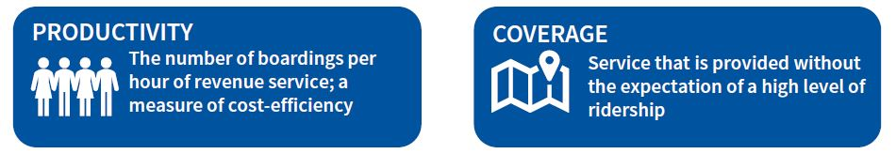
What are service standards?
Service Standards are the goals set for transit service which enable a transit agency and its partners to monitor transit performance against defined goals.
Defining Features
Service Targets
Outputs

Slide 13
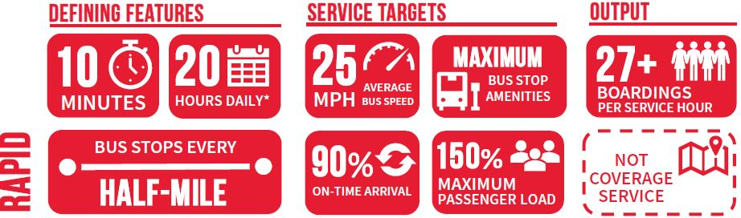
Service Categories: Rapid

Slide 14
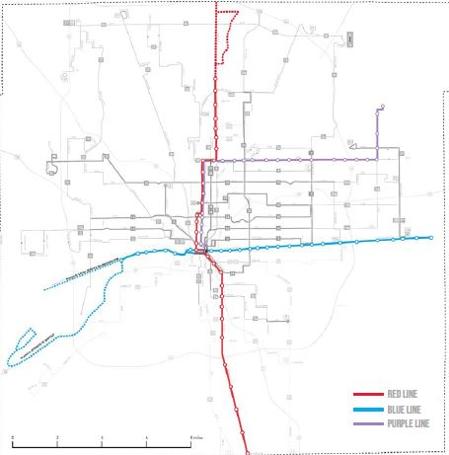
Service Categories: Rapid

Slide 15
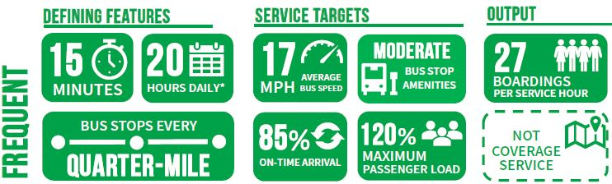
Service Categories: Frequent

Slide 16
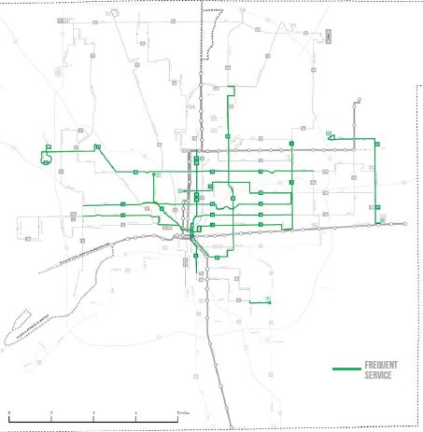
Service Categories: Frequent

Slide 17
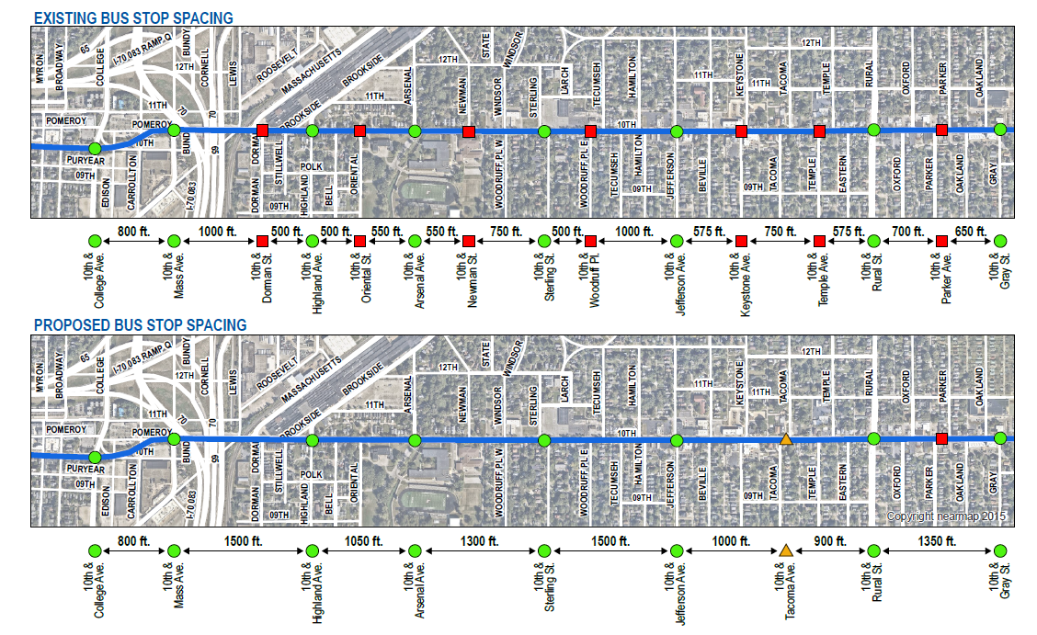
Bus stop balancing

Slide 18
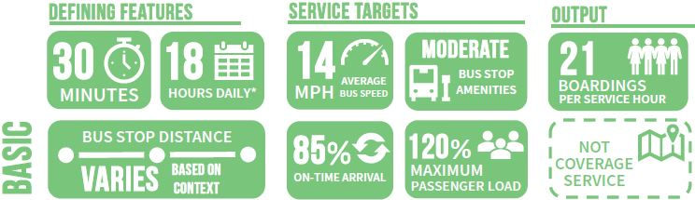
Service Categories: Basic

Slide 19
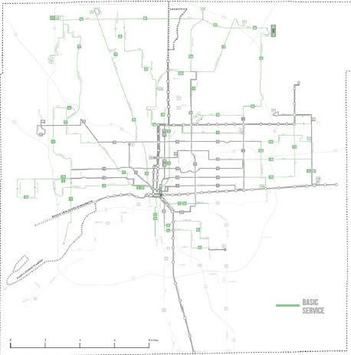
Service Categories: Basic

Slide 20
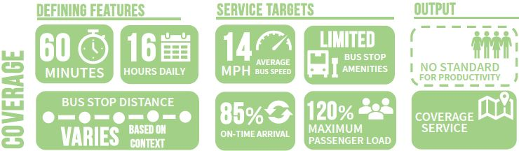
Service Categories: Coverage

Slide 21
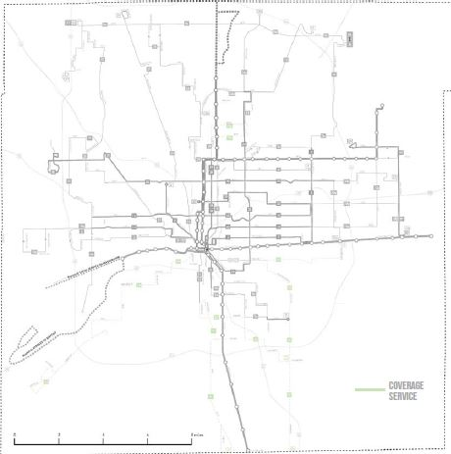
Service Categories: Coverage

Slide 22
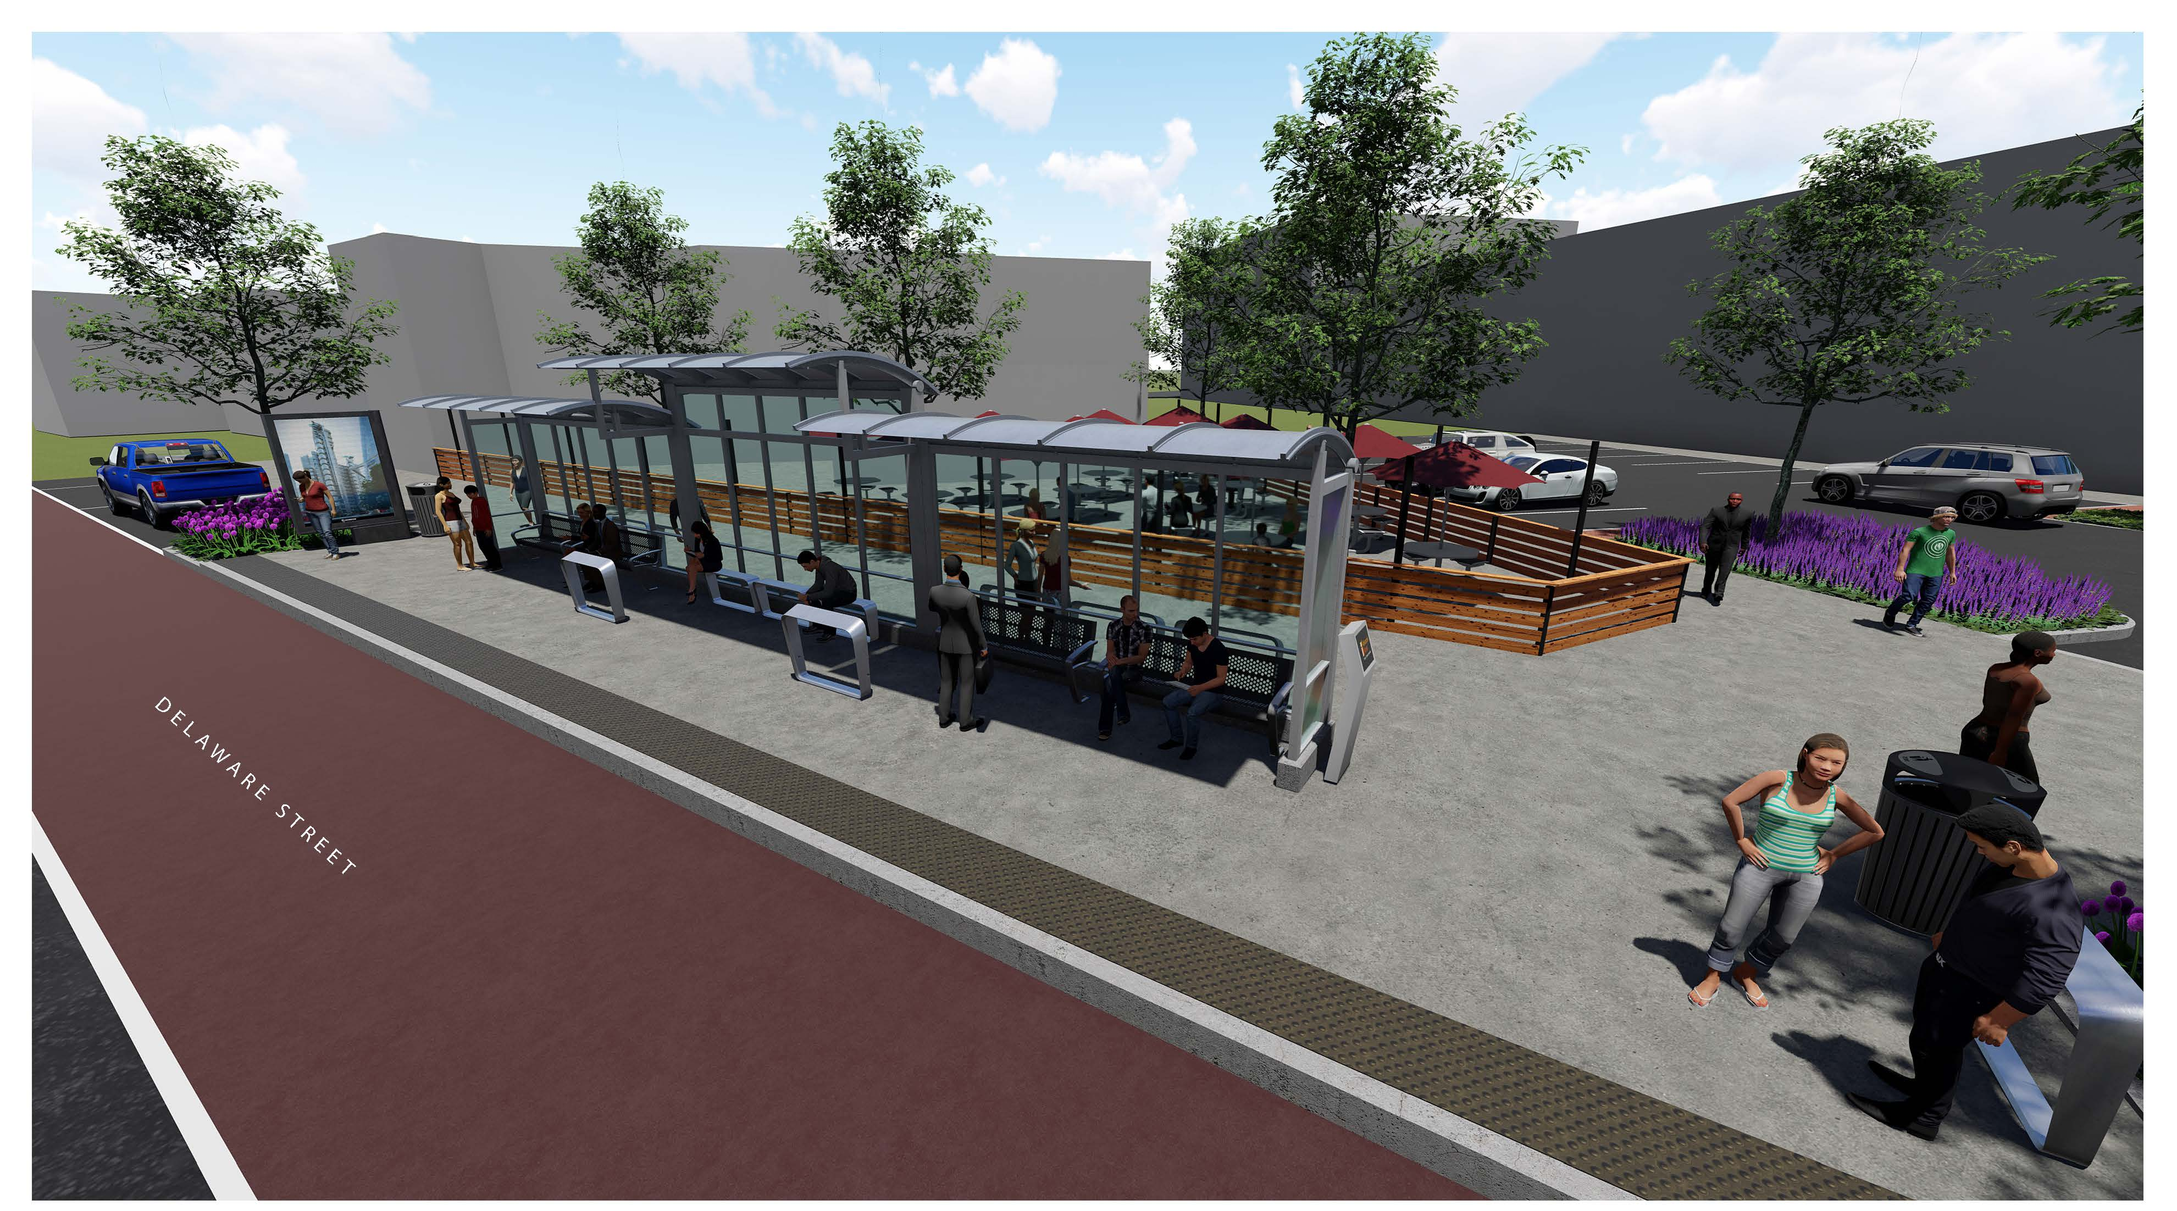
Next steps
Service Standards comment period
Develop tools for the public
Conduct public meetings
Provide feedback to the board
Advance a final document for adoption
Begin bus stop work
Open Red Line & launch new network

Slide 23
Indygo.net/transitplan
317-635-3344

